Slide 1

Seasonal Agriculture Performance Analysis
Name-Rishav Kumar
College Name-Graphic Era University
AICTE STU ID : STU679665ab419af1737909675

Slide 2

PROBLEM STATEMENT
Agricultural performance is shaped by seasonal variation in rainfall, temperature, humidity, soil conditions, resource use and market prices across Kharif, Rabi and Zaid seasons.
Raw farm-level records do not by themselves reveal how yield, cost, resource efficiency and profitability shift from one season to another.
This project analyzes a 4,000-record, multi-state farm dataset (8 states, 8 crops, 4 irrigation methods) to uncover meaningful seasonal patterns, trends, relationships and variations in agricultural performance, and to derive evidence-based, data-driven recommendations.

Slide 3
Project Description This project analyzes seasonal agricultural performance using a 4,000-record dataset spanning 8 Indian states, 8 crops, 3 seasons (Kharif, Rabi, Zaid) and 4 irrigation methods, with 28 attributes covering environmental conditions (rainfall, temperature, humidity, soil), farming inputs (fertilizer, pesticide, irrigation), yield, and economic outcomes (cost, revenue, profit, water efficiency). The workflow - cleaning missing values and capping outliers, exploratory data analysis, statistical testing (ANOVA, Pearson correlation) and visualization - is fully documented in a Google Colab Jupyter Notebook, followed by season-wise comparison of yield, profitability, resource efficiency and risk, concluding with data-driven recommendations for seasonal agricultural planning.

Slide 4

WHO ARE THE END USERS?
Farmers & farmer cooperatives - plan sowing, irrigation and input use season-wise
State agriculture departments & extension officers - issue evidence-based seasonal advisories
Agri-input suppliers (fertilizer, seed, pesticide companies) - anticipate seasonal demand by region
Agri-fintech, lenders & crop insurance providers - assess seasonal profitability and risk
Researchers, agri-tech students & policy analysts - case study for data-driven agricultural planning

Slide 5
Technology Used
Google Colab (Jupyter Notebook) - cloud analysis environment
Python 3 - core programming language
Pandas & NumPy - data cleaning, transformation and aggregation
Matplotlib & Seaborn - statistical visualization (box, violin, bar, heatmap plots)
SciPy (stats) - ANOVA and Pearson correlation hypothesis testing
CSV dataset (Google Drive / local upload) - data source
Microsoft PowerPoint - presentation of findings

Slide 6
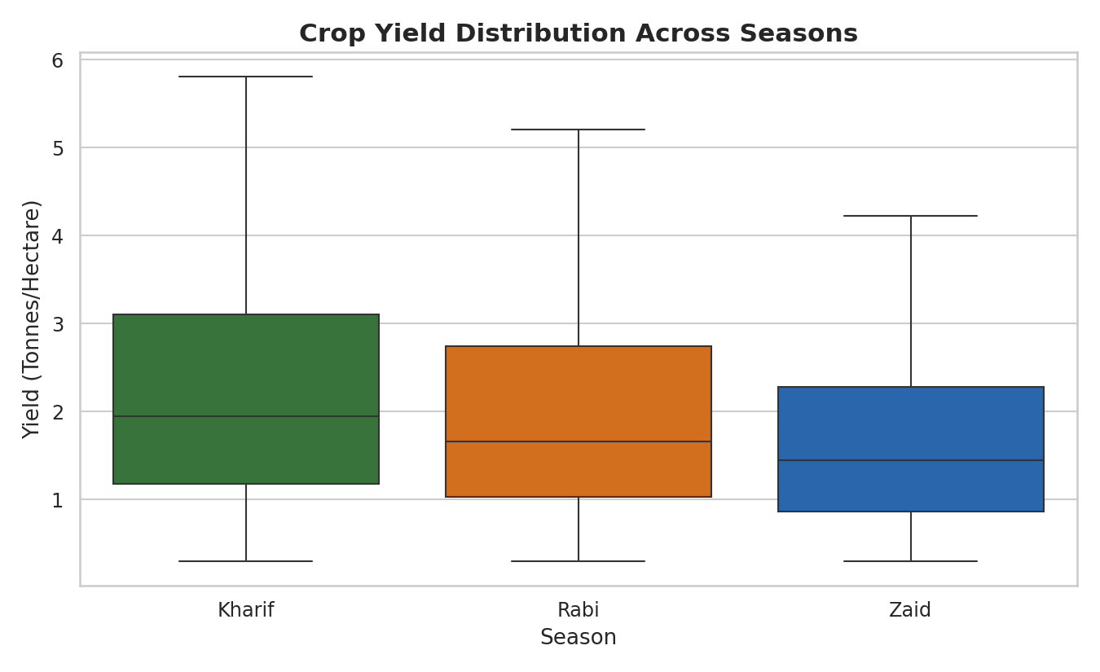
RESULTS
Kharif shows the highest median yield; ANOVA confirms seasonal yield differences are not statistically significant (p = 0.28).

Slide 7
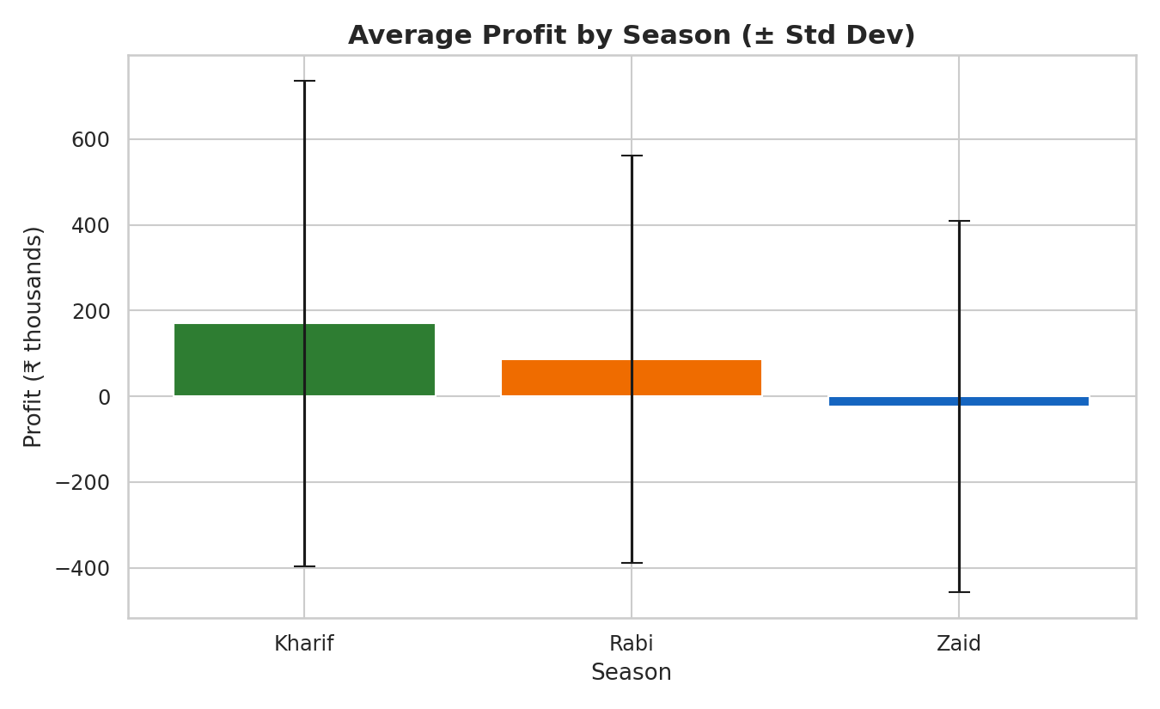
RESULTS
Profit differs significantly across seasons (ANOVA p < 0.001): Kharif is most profitable on average, Zaid the least.

Slide 8
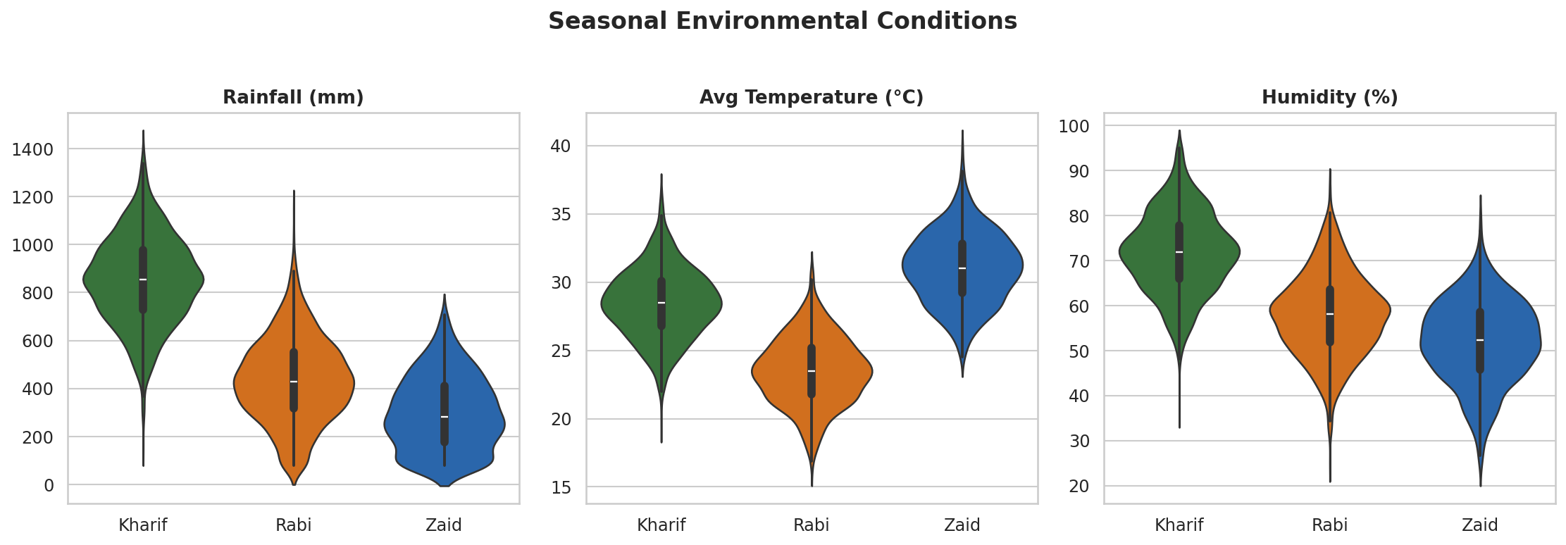
RESULTS
Rainfall, temperature and humidity vary sharply by season - Kharif is hottest & wettest, Rabi is coolest & driest.

Slide 9
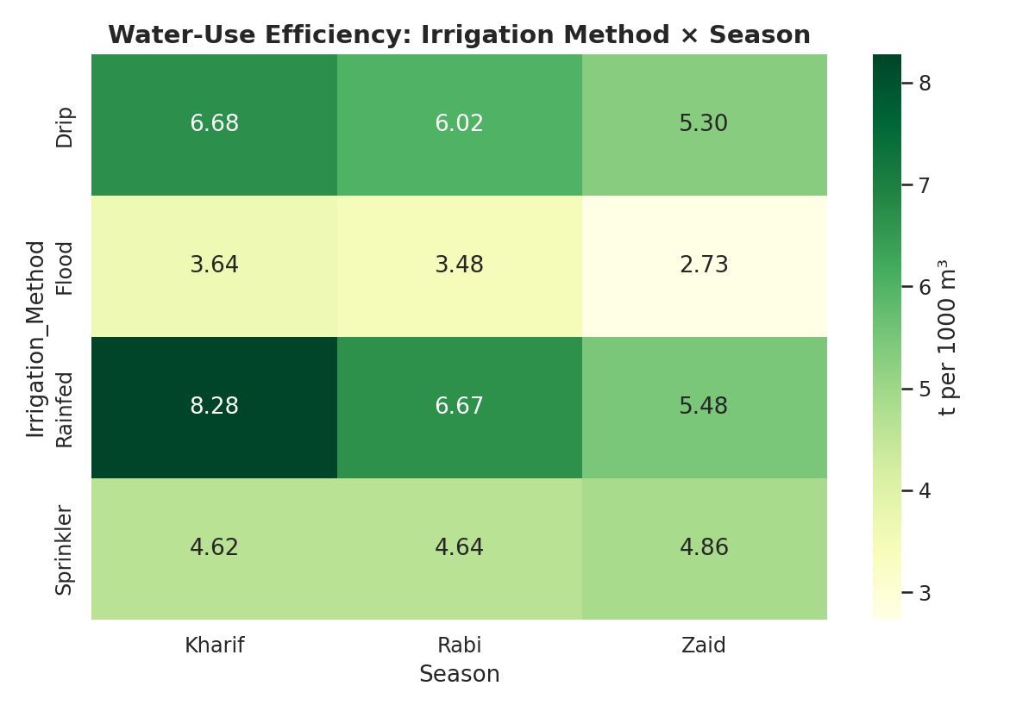
RESULTS
Rainfed and Drip irrigation are the most water-efficient methods across all three seasons; Flood is the least efficient.

Slide 10
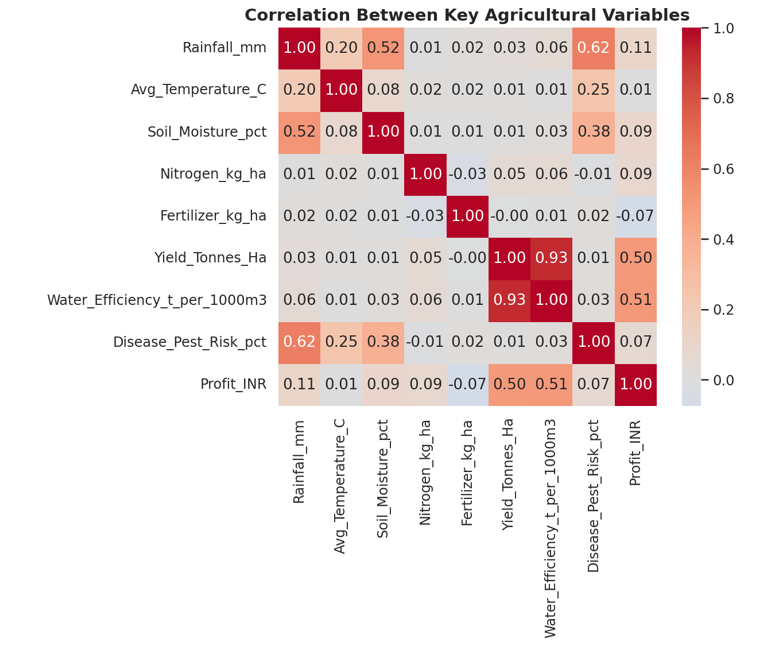
RESULTS
Yield correlates weakly with rainfall/fertilizer alone - profitability is driven more by market price and cost control than raw input volume.

Slide 11
Future scope
Data & Modeling
Deployment & Impact
Extend the dataset with multiple years to study year-on-year seasonal trends, not just a single cycle
Add district/region-level weather forecast data to move from descriptive to predictive analysis
Build a machine learning model to predict yield or profit from seasonal & input conditions
Include soil-type and satellite/remote-sensing data for deeper environmental analysis
Package findings into an interactive dashboard (e.g. Streamlit / Power BI) for farmers & officers
Generate automated, season-specific advisories on crop, irrigation method and input dosage
Integrate with crop insurance/lending workflows to support seasonal risk-based decisions
Pilot with a state agriculture department or FPO for real-world validation and feedback

Slide 12
GitHub Link
Repository
Contents
Rishav387/seasonal-agriculture-performance-analysis: Seasonal Agriculture Performance Analysis — VOIS AICTE major project analyzing 4,000 farm records across Kharif, Rabi & Zaid seasons in Python (Pandas, Seaborn, SciPy) on Google Colab. Covers data cleaning, EDA, ANOVA/correlation testing, and season-wise insights on yield, profit, irrigation efficiency, and crop performance.
Seasonal_Agriculture_Performance_Analysis.ipynb - full Colab notebook
seasonal_agriculture_performance_dataset.csv - raw dataset
seasonal_agriculture_cleaned_data.csv - cleaned dataset used for analysis
README.md - project overview, objective and how to run
This PPT - submission presentation

Slide 13
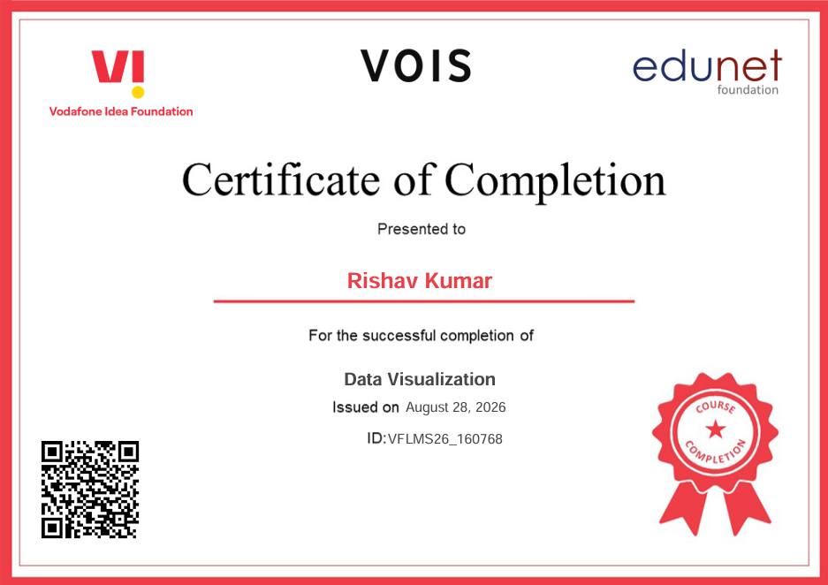
VOIS Course completion certificate - Course name- Data Visualization

Slide 14
Thank you
.
.

